Slide 1
Valve Partner portal
Neles sales instructions

Slide 2
Content
Quotation process (p 3)
Chatter functionality (p 5)
Turn quotations to orders (p 7)
Send order Acknowledgement (p 12)
Request for the Partner PO upload (instructions needed)
Sharing a Sold-to Account to Distributor (p 15)
Item Category (p 20)
Send message to Partner chatter group (marketing team) (p 22)
Create a lead (p 23)

Slide 3
Roles & Responsibilities
Partner Portal QUOTATION process
End customer
No
Accept proposal
Sign contract with Metso Partner
RFQ
Customer asks for product update
Yes
Read spec and datasheet
Nelprof sizing, product selection
ETO flags
Prepare pidding document and propose to customer
Any T-flags remain
Yes
Send order request
No
Metso Partner
Yes
No
Send SR to IQI team with SR comments if necessary
Receive SR and check quoted items and IQI comments
Send SR again to IQI to clear the T-flag
Upload OA
Metso Sales
Quotation related advise – use chatter
quotation related advise – use chatter
Place order to metso factory
Global Application team
Propose valve strategy, help with Nelprof (Zendesc)
Clear P- and L- flags, clarify Technical issues with T-flag and close SR
Clear T-flag and close SR
Order
Metso Factory/IQI team

Slide 4
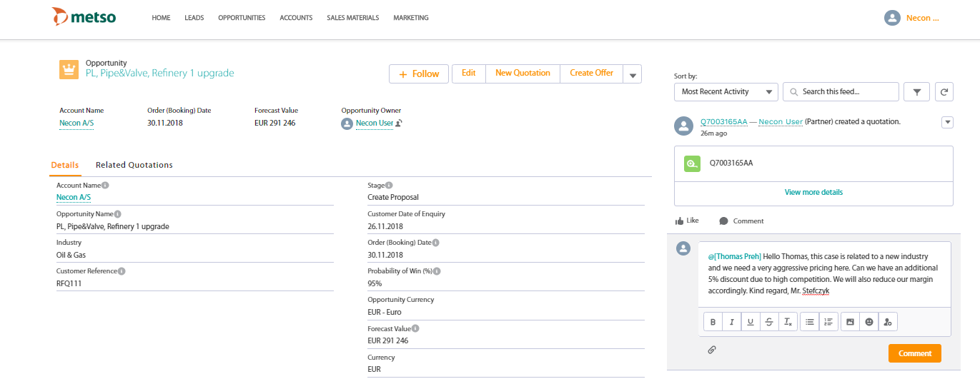
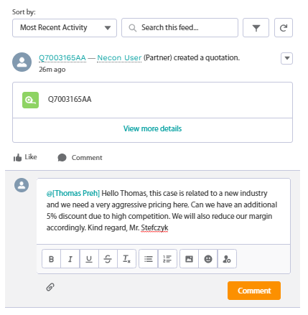
Metso Sales Office Role & Responsibility
Metso sales role: Support in sales strategy and quotation and commercial issues
Support case:
Partner can send questions to the “Partner team” with SFDC chatter. You should not accept quotation / opportunity related requests sent by email, because they are then not linked and attached to the quotation in question and no one can back track those afterwards from your inbox
Start writing: “@name…” and the partner team members should appear as an email in the chat box
“Partner Team” – only members in the team can be received by partner chatter. If not all relevant people are found in the chatter, pls contact your distribution organization to add new members
After partner sends you a chat, you will get a note in your email that you have received a chat. Click the link and you can add your comments
Typical issues to be changed by Sales:
  New ship to-address (if not existing in the predefined list)
  Change incoterms e.g. From CPT to FCA
  Advise best suitable valve
  Advise sales strategy
  Agree discounts
  The partner cannot access these fields in SFDC and needs to request Sales to change/support them

Slide 5
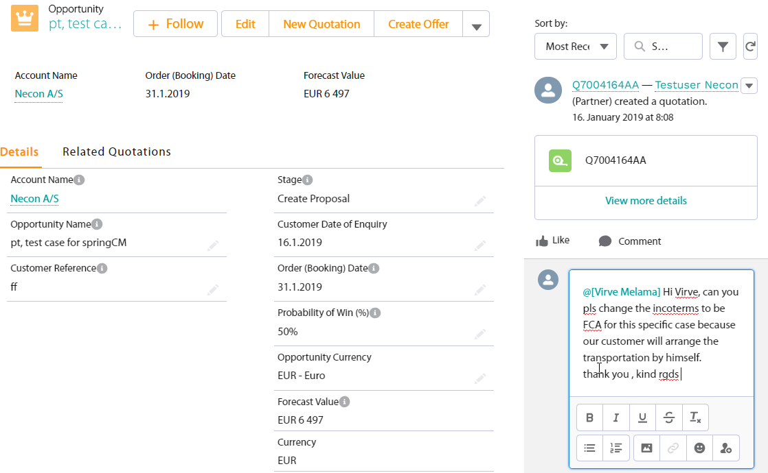
Chatter: How partner can change T&C parameters
Partner needs to send a chatter where he describes the request
This way the communication stays within this specific case and can be reviewd also by the colleagues

Slide 6
Metso Sales Office Role & Responsibility
Main Sales main role: Place orders on behalf of Distributors
Orders
After the partner has completed his quotation and the quotation is ready to be ordered the Partner changes the Quotation to an ”order request”
Partner:
  Change status to ”closed-won”
  Add ship to address
  Add ”PartnerToMetso” PO nr’s
  Add customer references (optional but recommended)
  Upload ”PartnerToMetso” PO file to the portal
Metso:
  Check (order handler) DAILY the report from SFDC: “Agent orders ready to transfer to ERP“ (old report name: Agent orders ready to transfer to ERP)
  If exists, review the order and send it to ERP
    Check that PO file is attached
    If partner agreement has some restrictions e.g. no spare parts allowed, review the items they are not including spare parts. This however is very rarely the case
  All commercial issues have been predefined so those should not be necessary to be checked (T&C, price level, lead times etc.)
  See following print screens for the steps and actions

Slide 7
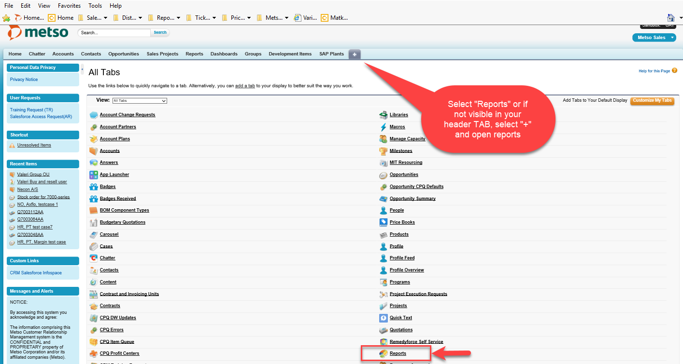
Turn quotations to orders
Select the report ” Distributor orders rdy to transfer to ERP”

Slide 8
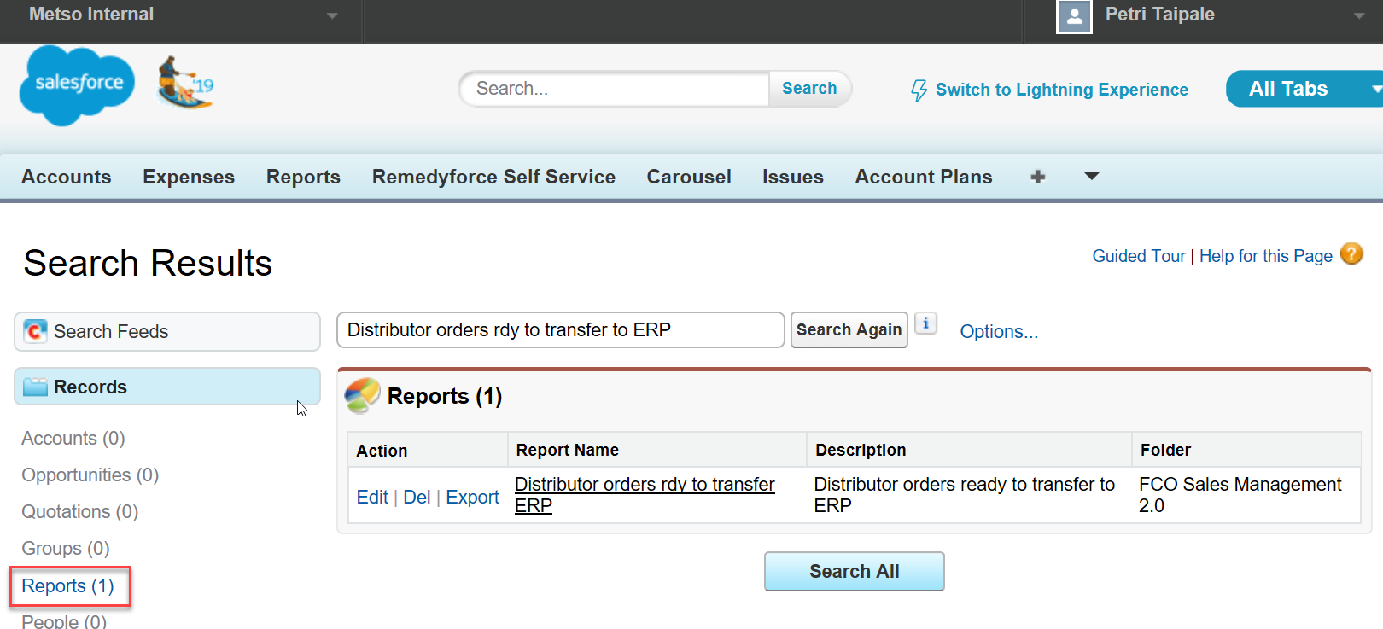
Open report to see new order requests

Slide 9
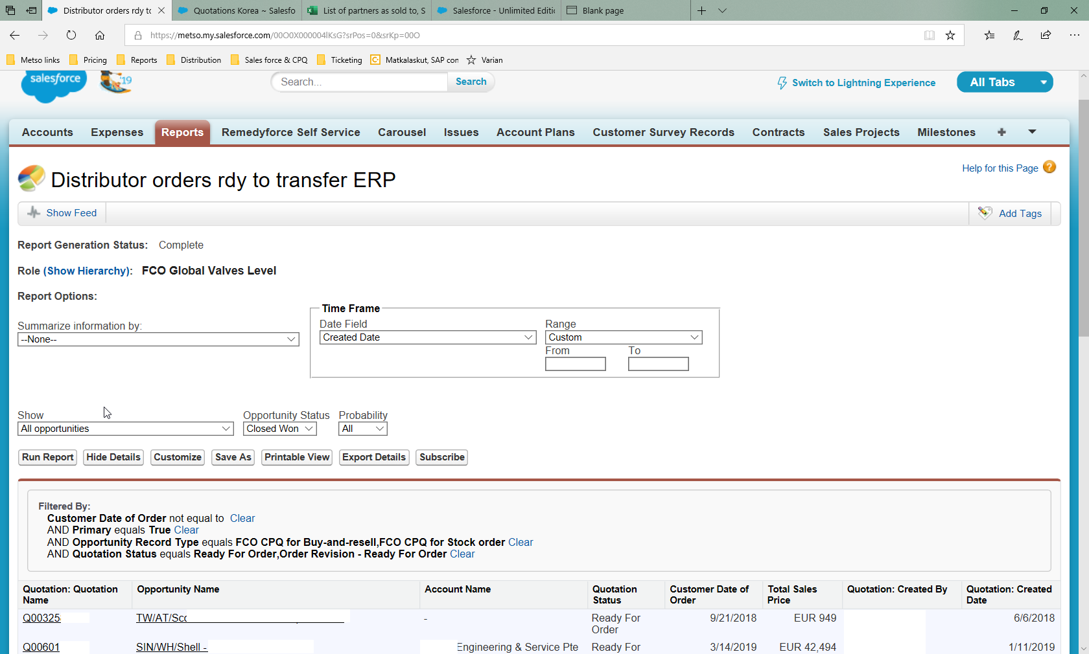
Actions with the ”order requests” placed by Partner
Select the Quotation and do normal actions to send the order (Add “opportunity team” → send order)

Slide 10
Roles & Responsibilities: ORDER
Metso Sales is responsible of excecuting the order revisions

Slide 11
Metso Sales Office Role & Responsibility in Order Revision
Sales role: Communicate and initiate the order change request from Partner
Send revision approval for order change on behalf of Distributor due to complicated OC-process (order change)
  State clearly the reason/cause of order change to IQI
  Communicate between Distributors and IQI for clarifying and confirming change requests and demands
  Inform Distributors of order change cost and delivery time impact
    System improvement planned→lead time changes to be presented in Portal)
  Place revised order ASAP if order change confirms (order change may be cancelled due to high cost impact or delay)

Slide 12
Adding order acknowledgement document
1. Send by email from ERP
2. Upload pdf doc from your hard disc

Slide 13
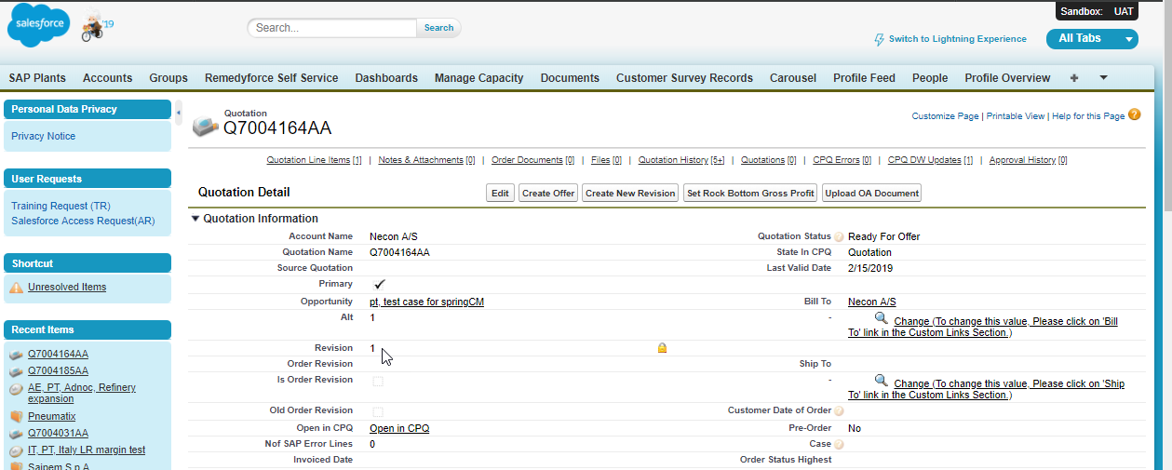
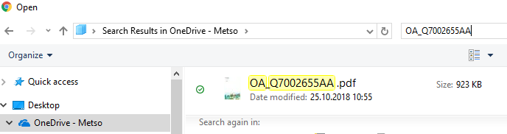
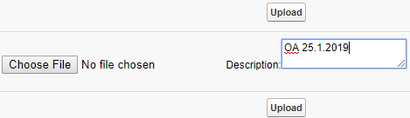
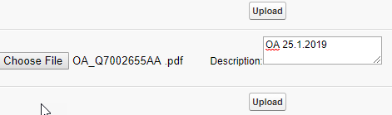
Adding order acknowledgement document
Upload to the SFDC
Upload to SFDC
Metso Sales coordinator (who has the ERP access license) will add the order acknowledgement to the opportunity.
From there it is visible for Metso sales as well as for the distributor
(Sales coordinator) print out the OA from SAP/iScala/M3 when it is available and save it to the hard drive
In SFDC select the QUOTATION and click the “upload OA document”
give a description and select the file from his hard drive to be uploaded
Select the file and click “open”. The file will be selected.
Click “upload”
2
3
4
Note: Metso sales person needs to request for privileges thru SSM.
The permission should be : "Salesforce CRM Content User".
5

Slide 14
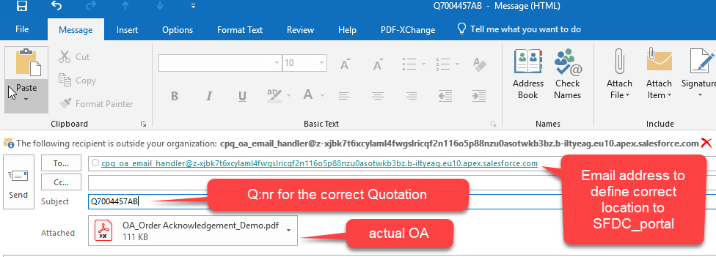
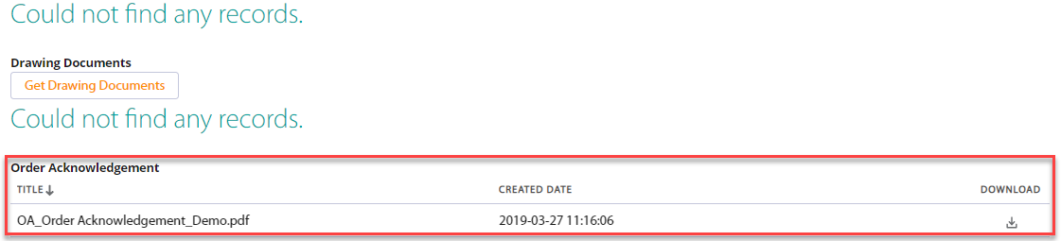
Adding order acknowledgement document
Send by mail (easier)
Send by mail
Email address:
cpq_oa_email_handler@z-xjbk7t6xcylaml4fwgslricqf2n116o5p88nzu0asotwkb3bz.b-iltyeag.eu10.apex.salesforce.com
Set Q-nr as the “Subject” and actual OA as attachment
HINT: you can also add several recipients to the mail “to”-field
Note
For testing environment you can use this email:
cpq_oa_email_handler@2t5hepcnb2shshhagf7lsqpqg7s0zty9vwos4malent99a3kuo.1q-pxdeau.cs107.apex.sandbox.salesforce.com

Slide 15
Instructions of sharing a Sold-to Account to Distributor
14.1.2019

Slide 16
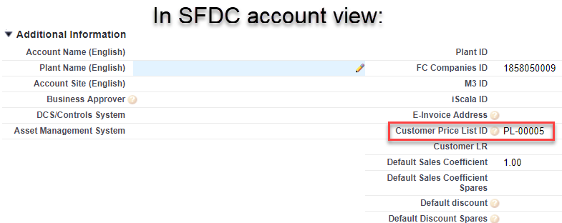
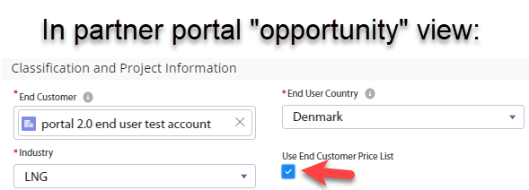
Why to share the sold-to account to the partner?
All sold-to accounts are property of Metso Flow thus we should not share all sold-to account to every partner freely.
As by default, no End Customer is shared automatically with the partner (=distributor).
Partner can only create a prospect by them self to have an End Customer
In desired occasions Metso sales can share in SFDC a specific sold-to account to the specidict partner
Resons why to share
  Installed base cannot be backtracked from prospects. A prospect is in this sence a dummy End Customer
  If the sold-to End Customer has a price list, by clicking the check box ”use end customer price list” in the partner portal when creating the opportunity, the price list of that End Customer is used instead of partners own pricing level
    These price books exists typically on global accounts like UPM, DOW and others. This can be seen if you open the sold to account and check, if the price book is included.
    The price book has an ID ”PLxxx” in SFDC and the actual price book can be found in the CPQ

Slide 17
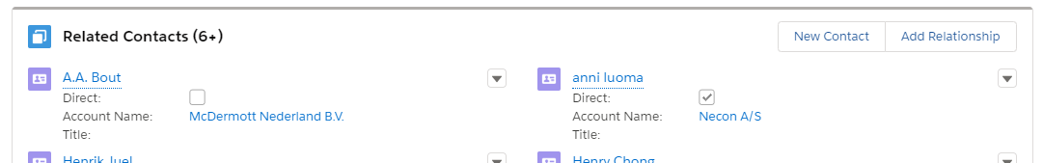
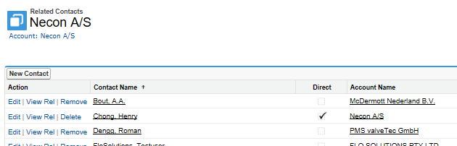
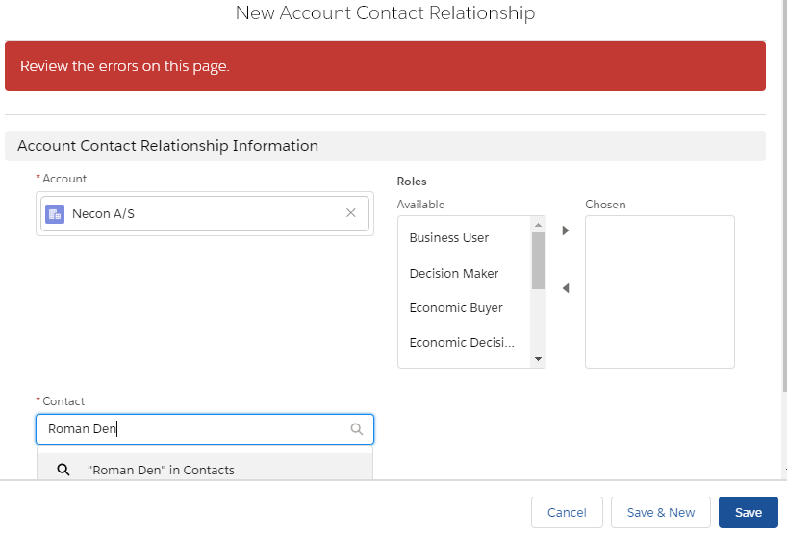
Lightning: Select the account to be shared
Go to the account
Select ”Related contacts” and ”add relationsip”
Write name of the person yopu want the account to be shared -> ”Enter”
This person can see the shared account in Partner portal and he can select the sold to-accont as end user.

Slide 18
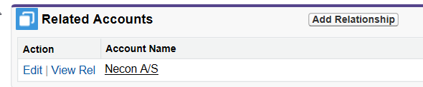
Sharing End user
If you have several end user accoutns to be shared for several partner users you can prepare a list for SSM-support to help you with this work
In the list you need to mention
  Account name you want to share
  SAP ID (to be exact)
  Name of the user you want the account to be shared
  Make sure the partner users exist as a contact punder the partner account
Account name | SAP ID | Name of partner user
Necon S/A | 501232 | Roman Denng
Necon S/A | 501232 | John Smith
You can check for all the shared accounts from
the following Report:
” Accounts shared to distributors through related contacts”
Hint: You can also open the contact and look for the ”related accounts” object which shows ALL accounts shared with that contact (see below)

Slide 19
Item Category

Slide 20
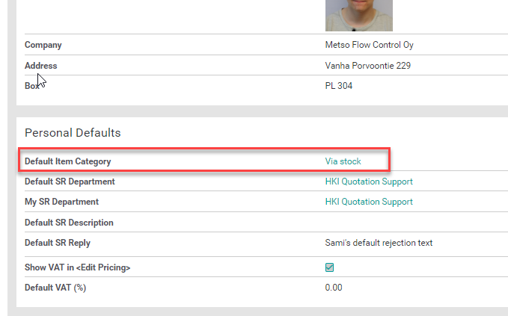
How to make the default for Item category
(via stock, drop Shipment...) for Distributors
All partners according to this mapping will now get a default item category of drop shipment or via stock when they add new lines to CPQ. Not affecting any lines already created in CPQ.
For you, as sales, you can update the default item category here;
https://cpq.metso.com/profile

Slide 21
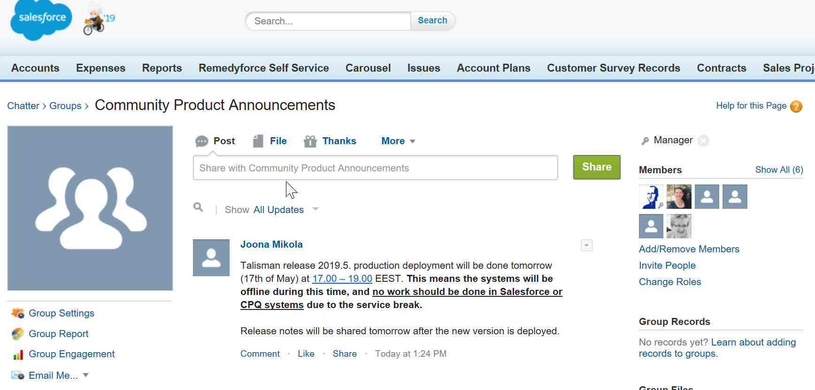
Send message to Partner chatter group
(Marketing team responsibility)
To be able to post announcements to the partner community chatter group you need to be a ”group manager”
Here general announcements and warnings, promotions can be added to reach all distributors using the portal

Slide 22
Create a Lead to the partner
When customers contact Neles Website and leave their contact request, they cenerate a lead for us
Neles team is reviewing the leads constantly and sharing those leads to sales offices
Sales office can decide, whether the lead is internal or should it be shared to our distributors
When the lead is shared to our distributor, they will pick up the responsibility of the lead handling and we can follow it in SFDC

Slide 23
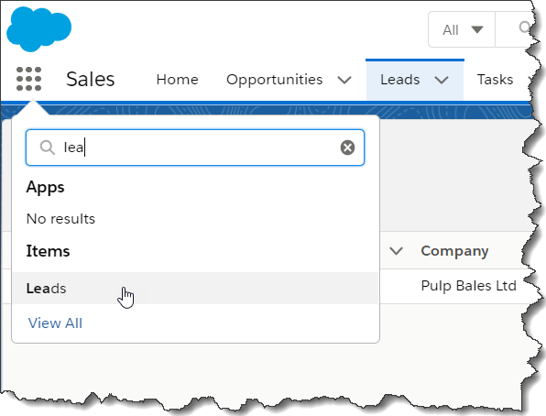
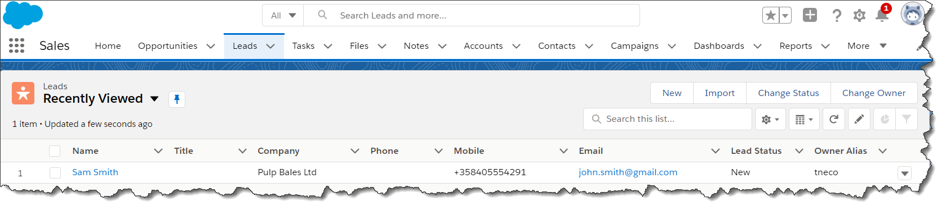
How to share a lead to distributor
In your Salesforce, go to the ”LEADS” app.
On the ”LEADS” app, select your lead, if the lead is not there, you can easily create a new lead
Select this and look for ”LEADS”
Select this
From here you can create a new lead

Slide 24
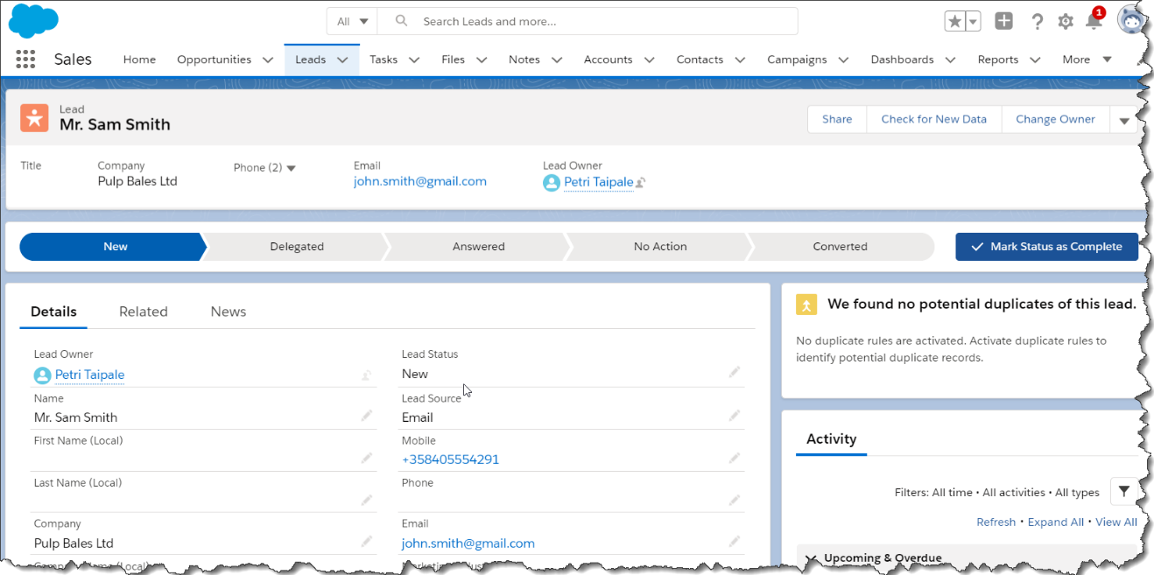
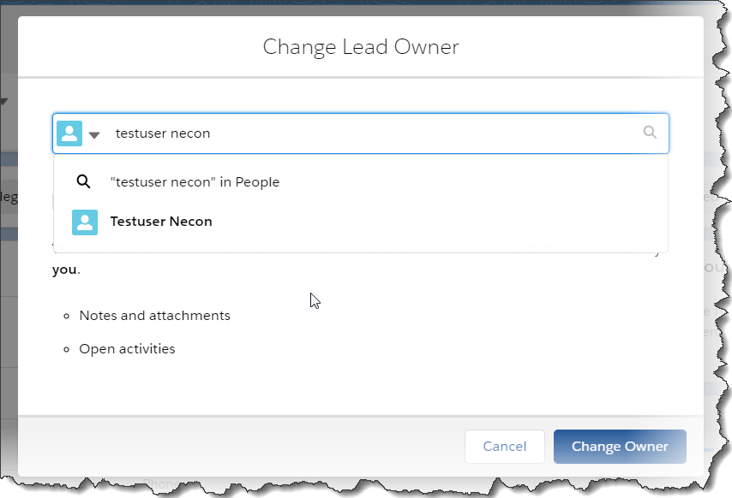
Select actions to share lead (in Lightning-SFDC)
Click
”Change owner”
You need to assign the lead to your distributor
The lead can be assigned to a person (possibly also shared to other users as well)

Slide 25
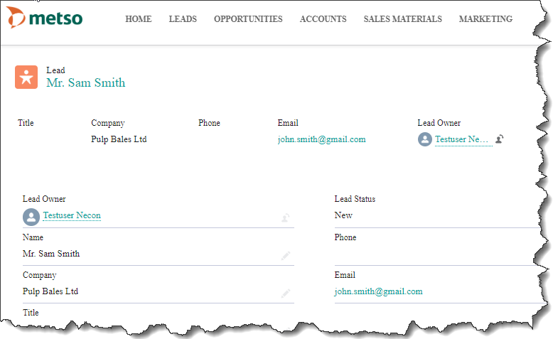
Assign lead to a partner
Write the queue or person to the ”share ”-field
Press ”change owner”
Distributor will see this as a new lead in the partner portal
They can change the status and share it within their team

Slide 26
neles.com

