Slide 1
Introduction to
Valmet Enterprise Risk Management
Based on Valmet’s Risk Management Policy 2022
Asko Partti
VP, Corporate Risk Management

Slide 2
Content
Risk management at Valmet
Risk Organization: Roles and Network
Risk management processes and Scope of Activities
Risk Categories
Valmet Risk Assessment
Valmet Risk Assessment Results 2023
Risks and business uncertainties

Slide 3
Risk Management at Valmet

Slide 4
Risk Management Processes in Valmet
Risk Management Policy
Updated annually
Approved by BoD
Risk Map and Risk Assessment
In Risk Map key risks identified
Risks assessed annually
Risk Treatment and Residual Risk
Treatment actions and accountability determined
Risk Management Evaluations
Frime, Logistics and Risk Engineering audits
Intenal and Extenal Benchmarks
Audit results and peformance evaluated against a peer group
Crisis Management Procedures
Crisis Mgmt Team
Incident Mgmt Team
Global Insurance Programs
Liability, Marine Cargo, EAR, Property Damage, Business Interruption, Travel and Expat
Risk Management Network
Risk Mgmt Team
Controller network globally
Instructions, Awareness and Training
Flow and Notes database
Training sessions

Slide 5
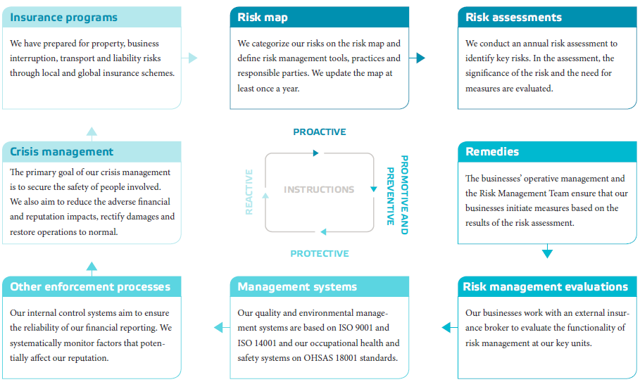
Risk Management Processes
Our risk management process is set up to identify and manage risks in order to strengthen our business

Slide 6
Corporate Security
Components & Owners
Corporate Security
1 Production and Operations Security
2 Occupational Health and Safety
3 Environmental Safety
4 Rescue Operations
5 Contingency planning
6 Information Security
7 Personnel Security
8 Premises Security
9 Foreign Ops Security
10 Crime Prevention
The division of corporate security into ten components is based on the model created by the Finnish Corporate Security Advisory Body of the Confederation of Finnish Industries EK.
Corporate Risk Management has overall responsibility for Corporate Security
Corporate Risk Management
Group Strategy/Health & Safety
Group Strategy/Sustainability & Technology
Group Human Resources
INTERNAL
Notes:
Corporate security is comprehensive unity that supports the objectives of a company by ensuring a safe and undisrupted environment for production, services, operations and working while also safeguarding business continuity.
It is high-quality co-operation that strives to maintain and improve the safety of the company, organization, personnel, assets, knowledge, reputation and the environment.
Corporate security involves everyday activities under the responsibility of management to prevent accidents, incidents, injuries and criminal activity, as well as to prepare for these situations as a natural part of the company’s risk management.
Safety management, general security principles and technical security systems are important elements of corporate security.
Each member of the organization through his or her own efforts can influence safety induction, training and personal responsibility arrangements.
The cornerstone of corporate security is a culture of safety, which is manifested in the actions of the company and its employees by paying attention to security considerations in both decision-making and grass-roots work.
1. Production and Operations Security
Production and operations security aims to achieve undisrupted, continuous and reliable operations. It focuses on the prevention of disruptions and rapid recovery from them. In addition, production and operations security seeks to ensure safe products and services. An effective production and operations safety concept allows a company to focus on core activities instead of addressing problems that are hampering production and operations.
2. Occupational Health and Safety
Occupational health and safety promotes safe working conditions and the wellbeing of employees. Occupational health and safety places multiple demands on senior management and all other employees – it is everybody’s concern. Occupational health and safety (OHS) consists of a target-oriented action plan, which includes concrete measures to prevent adverse health effects caused by work.
3. Environmental Safety
Environmental safety consists of taking ecological sustainability into account, anticipating the environmental expectations of customers and society, developing processes and best practices, taking responsibility for the environment, and increasing staff awareness.
4. Rescue Operations
Rescue operations include preventing fires and other accidents, a rapid and correction response to accidents, staff training and raising awareness, and managing risks by anticipating, eliminating, minimizing and insuring. Rescue operations are an integral part of the company’s safety plan.
5. Contingency Planning
Contingency planning is based on safeguarding defense economy planning and the security of supply in national emergencies. Contingency planning applies especially to so-called prioritized enterprises. The aim is to secure society’s vital functions in the event of major disruptions and crises.
6. Information Security
Information security means safeguarding the availability, integrity and reliability of vital information. Information security involves not only information technology, but also verbal communication between two people. Increasing staff awareness is a key factor in maintaining and improving information security.
7. Personnel Security
Personnel security involves protecting employees and customers from accidents, injuries and criminal activities, protecting business operations by ensuring the reliability of employees, protecting key employees, and safeguarding critical human resources.
8. Real Estate and Premises Security
Real Estate and Premises security means protecting a company’s valuable assets by means of structural and technical means, as well as by utilizing security and guard services.
9. Foreign Operations Security
Foreign operations security means ensuring the safety of employees when they are outside the country and do not have access to domestic services. It also entails eliminating or reducing potential risks in foreign locations.
10. Crime Prevention
Crime prevention focuses on preventing crimes against the company’s operations, personnel or property, both from within and outside the company. Crime prevention includes co-operation with officials to combat crime.

Slide 7
Goals of the Enterprise risk management
Support:
  the achievement of strategic targets and business objectives
  the continuity of operations
  strategic and operative decision-making and planning
  compliance with legal and regulatory requirements and international norms
Increase internal and external stakeholder confidence
Improve:
  governance and controls
  agility to take advantage of, minimize, remove or mitigate risks
  accident and loss prevention and incident management
  organizational awareness, learning and resilience

Slide 8
Risk Organization: Roles and Network

Slide 9
Risk Management as a part of Valmet’s governing bodies
Annual General Meeting
Nomination Board
External
Audit
Board of Directors
Internal Control
Audit Committee
Remuneration and HR Committee
Internal Audit
Risk Management
Group President and CEO
Executive Team
Business Line Presidents

Slide 10
Risk management organization and responsibilities at Valmet
Board of Directors
Overall responsibility
Audit Committee
Review responsibility
CEO, Exec Team
Business responsibility
Line Management,
Risk Managers
Corporate Risk Management
Risk Management Team
Implementation responsibility
Implementation approval and follow-up responsibility
Development, planning, implementation support and control
CMT
IMT
IMT
IMT
Metso Risk Management Policy

Slide 11
Valmet’s Risk Management Network Members
Head of Risk Management
Group Risk Manager
Risk Management Specialist
Asko Partti
Asko Partti
NN
Services risks
Bill Zervas
Paper risks
Heikki Koivula
Pulp and Energy risks
Niklas Nylund
Chris van Laar
Automation risks
Corporate IT risks
Corporate HSE risks
Victoria Larsson
Corporate Financial risks
Janne Puustinen
Reetta Antila
Risk Management Team
Katri Hokkanen, CFO
Rasmus Oksala
Asko Partti

Slide 12
Enterprise Risk Management Network at Valmet
Financial Risk Control
Metso IT Risk Manager
Internal Audit
Insurers’ Risk Manage-ment
External Auditor
Aon Risk Manage-ment Services
Risk Managers
Quality Managers
Metso Logistics
Sustaina-bility and Technology
Health, Safety & Environ-ment
Travel Manage-ment
Legal Affairs
Issues Manage-ment
Group Risk Management

Slide 13
Enterprise risk management network at Valmet
Global network
Treasury and financial network
Local point of contacts

Slide 14
Risk management processes and
Scope of Activities

Slide 15
Risk management processes at Valmet
Risk Management Policy
Risk Management Program
Risk Map
Risk Assessment
Risk treatment and residual risk management
Risk Management Evaluation
Internal and external benchmarks
Crisis management practices
Global insurance programs
Process reviews and development

Slide 16
Risk management practises at Valmet
Risk Management network
Instructions
Training and auditing
Communication and consultation
Risk awareness

Slide 17
Scope of risk management activities at Valmet
Implementation
Risk map
Risk assessments
Remedies
Risk management evaluations
Other enforcement processes
Crisis management
Insurance programs
Quality systems
Proactive
Reactive
Instructions
Promoting and preventive
Protective

Slide 18
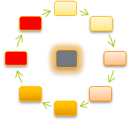
Risk management instructions
Corporate Governance
Strategic guidelines
Treasury Policy
Internal Audit Charter
Health, Safety and Environmental Policy
Information Security Principles
Enterprise Risk Management Policy
Risk Management Instructions
Corporate Security (Handbook)

Slide 19

Risk map
Risk classification
Main tools
Responsibilities

Slide 20

Risk Assessment
Risk recognition
Probability
Impact
Risk level
Actions, responsibilities, schedule

Slide 21
Risk Assessment - Common
Risk is calculated by multiplying the probability by the impact
P x C = R
1 – 5 x 1 – 5 = 1 - 25

Slide 22
Risk assessment process and utilization
Strategic Risk
Assessment
Results
Consolidation
Annual Report
Operational Risk
Assessment
Results
Valmet
Results
Board of Directors
Audit Committee
Assessment
Risk Management Team
Financial and Hazard Risk
Assessment
Results
Strategic Planning
Reporting segments Group
GOALS

Slide 23
Risk assessment principles
No actions needed
Follow-up
Long term solutions
Operational solutions
Immediate actions

Slide 24

Remedies
Risk assessment results and/or Business Impact Analysis results
Corporate Policies, principles, instructions and tools
Implementation:
Utilization, removal, mitigation, restriction

Slide 25
Risk management evaluations
FRiME audits, Compliance audits, Valmet IT audits, Insurers’ audits, other
Key risks, risk assessment results, Business Interruption Analysis results
Actions taken
Evaluation
Benchmarking

Slide 26
Risk management evaluation (FRiME)
Risk management evaluation means evaluation of the risk management level at Valmet's units globally.
The purpose of the risk management evaluation is to help Valmet's units to identify potential risks, find the best ways to manage risks and to train the unit’s personnel to use existing tools and procedures to manage risks. It is also important to unify and improve the practices and to share the information and best practices across the company.
The level of risk management and actions taken are evaluated by Group Risk Management function using Valmet's insurance broker's "Flexible Risk Management Evaluation" -tool (called FRIME).
The intention is to cover about 80% of Valmet’s annual net sales and have a selection of units representing also a wide geographical and functional coverage. Based on the definition, the number of the key units is about 50. The evaluation is conducted annually in five of those fifty most significant units.
The two-day evaluation consists of first day's part of operational and hazard risks management evaluation. Second day starts by introducing the results to the management of the unit/function. Strategic risk and financial risk management evaluation is conducted after the introduction.
The tool consists ca. 185 questions relating to strategic, financial, operational and hazardous risks. The operational risks section includes questions related to compliance and crime as well as equal opportunity and freedom of association.
More information about FRiME audits can be found in 1.3 Risk and Crisis management.

Slide 27

Quality systems
ISO9001, ISO14001, OHSAS18001
Prioritization
Integration of remedies into
quality auditing
Risk management evaluation
results

Slide 28

Other enforcement processes
Risk management evaluations’ results
Opportunities, weaknesses, threats
Cooperation:
Strategic Planning, Financial Audit, Financial RM, Internal Audit, Compliance Program, Metso IT RM, OHS, Insurers, other

Slide 29

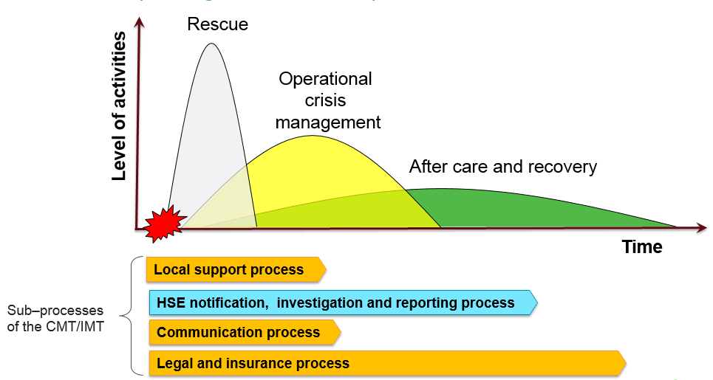
Crisis management
Priority of actions taken in crisis
Secure the personnel
Decrease the severity
of the damage
Find out the ways to continue the activities of the Company
Restore the facilities and the organisation

Slide 30
Crisis management organization
CMT¹
Internal support
External support
IMT²
Customer sites
Business travelers
Locations
Crisis Management Team
Incident Management Team

Slide 31

Crisis Management Team (CMT)
CFO (Chairman of the CMT)
SVP, General Counsel
SVP, Human Resources
VP, Group Risk Management (Vice.chairman)
SVP, Group Communications

Slide 32

Internal support
Occupational Health and Safety
Production
Environment
Information Technology
Other

Slide 33

External support
Security consultants
Travel agencies
Insurance companies
Foreign Ministries
Other authorities in question (Police, Frontier authorities, Customs etc.)

Slide 34

Global insurance programs
Property Damage, Business
Interruption and EAR Insurance
Marine Cargo and
Inland Transit Insurance
General and Product Liability
Insurance
Director’s and Officer’s Liability Insurance
Other insurance Administration

Slide 35
Risk Categories

Slide 36
Definition of Risk
Effect of uncertainty on objectives (ISO31000:2009E)
Risk is a combination of the probability of an event and its consequences (ISO/IEC Guide 73)
Risk is either an opportunity or threat or combination of both aspects

Slide 37
Definition of Risk and Risk categories & implications in Valmet
Definition of Risk
Effect of uncertainty on objectives (ISO31000:2009E)
Risk is either an opportunity or threat or combination of both aspects
Risk categories & implications
Strategic risks
Input into strategic planning
Financial risks
Financial market impact on business operations
Operational risks
Support to meet the current business result objectives
Hazard risks
Enforcement of strategy implementation
Background for corporate level critical threat evaluation
Development and implementation of corporate finance and funding strategy
Content and implementation of the Treasury Policy
Secure continuity of operations
Be part of internal control environment
Initiate preventive measures to avoid incidents
Support and enforce measures in Health, Safety and Environment related issues
Secure continuity of operations

Slide 38
Risk categories
Risk is either an opportunity or a threat or combination of both aspects
Threats
Strategic risks
Opportunities
Threats
Financial risks
Opportunities
Threats
Operational risks
Opportunities
Threats
Hazard risks

Slide 39
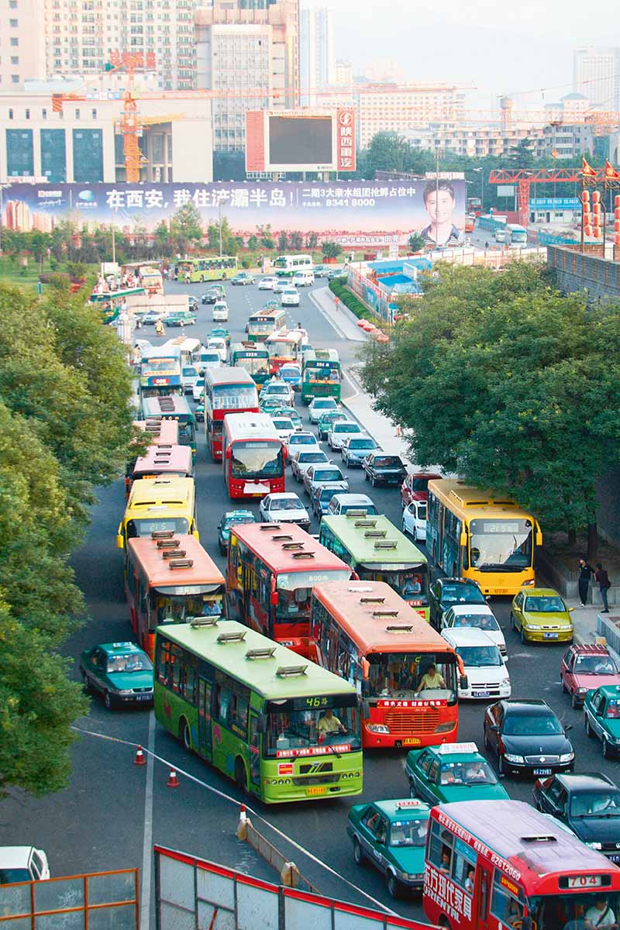
Strategic risks
Business development risks
Business environment risks
Market risks
Technology risks
Political, regulatory, legislative and cultural development
Global climate, environmental and other phenomena

Slide 40
Financial risks
Liquidity
Interest rate risks
Currency risks
Credit and counterparty risks
Pension assets and liabilities risks

Slide 41


Operational risks
Organization and management related risks
Information security risks
Production, process and productivity risks
Business interruption risks
Profitability risks
Project activity risks
Contract and liability risks
Crisis situations
Compliance and crime related risks

Slide 42
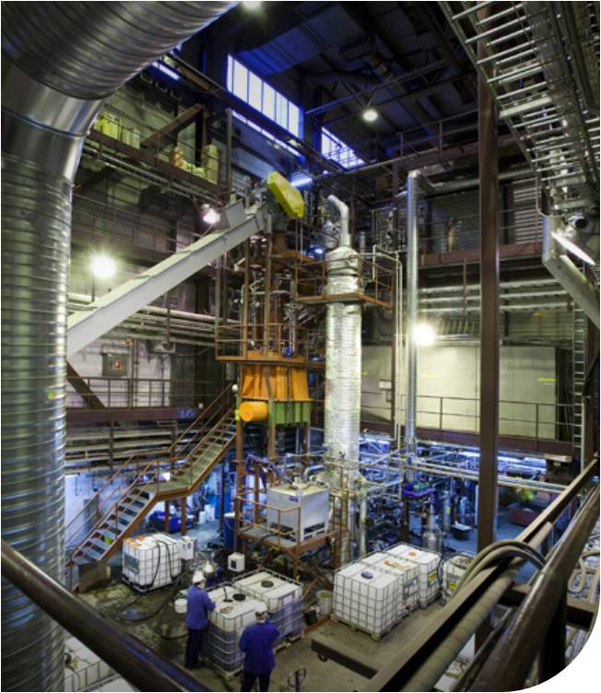
Hazard risks
Occupational health and safety related risks
Personnel security risks
Environmental risks
Fire and other disasters
Natural events
Premises security risks

Slide 43
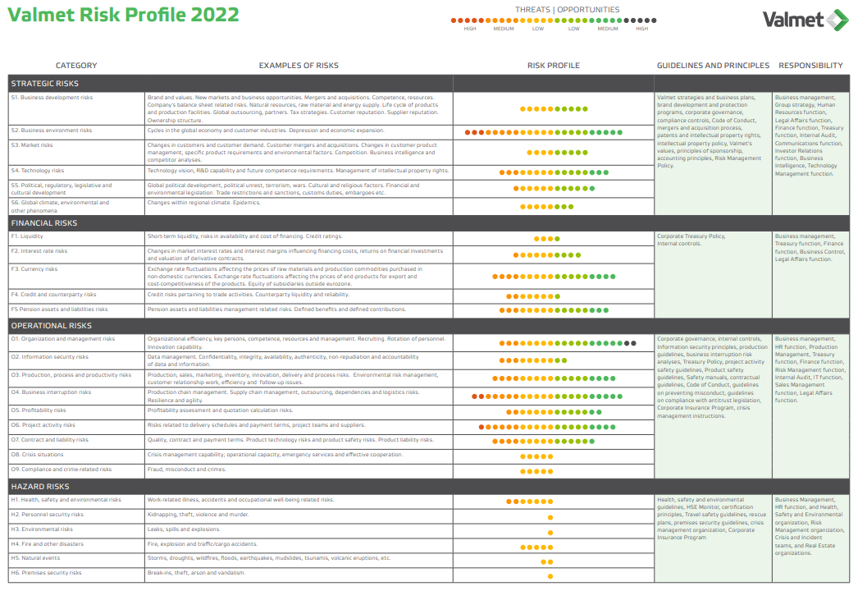

Slide 44
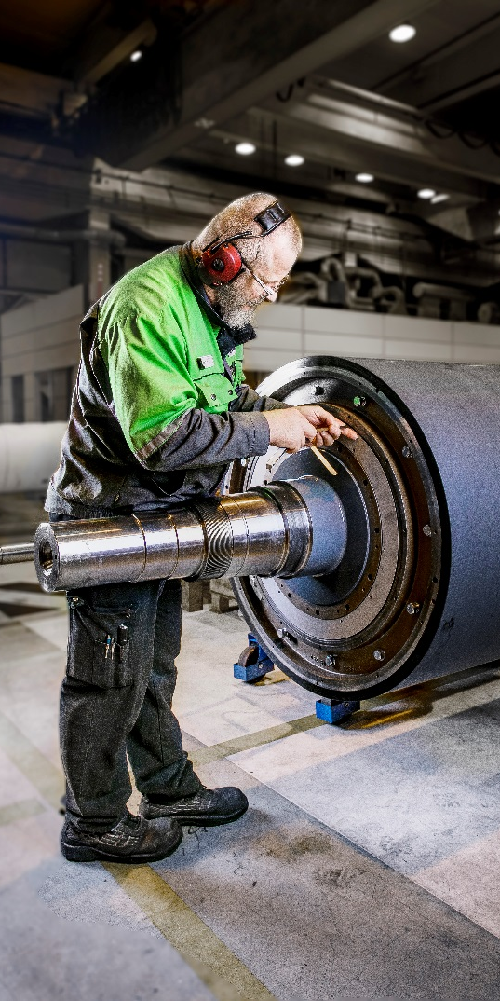
Risks and business uncertainties
Forewords
Valmet’s operations are affected by various strategic, financial, operational, and hazard risks.
Valmet takes measures to exploit emerging opportunities and to limit the adverse effects of potential threats.
If such threats materialized, they could have material adverse effects on Valmet’s business, financial situation, and operating result or on the value of assets, shares and other securities.

Slide 45
Risk Assessment Process
Basis on Risk Management Policy and ISO 31000 standard
19 workshops in 2022, participants from all BL’s and selected functions
Annual process to assess identified key risks
Valmet’s risk appetite is defined in the annual Risk Assessment process in which threats and opportunities are evaluated against Valmet’s targets and objectives.
In assessing risks, Valmet takes into consideration the probability of the risks and their estimated impact on net sales and financial results.
In the assessment the significance of the risk and the need for measures are evaluated

Slide 46
Risk Assessment Process
As a key principle, risk management promotes opportunities. Furthermore, it aspires to minimize the adverse impacts of strategic, financial and operational risks and to remove or mitigate the hazard risks.

Slide 47

Summary
Risk is identified as an effect of uncertainty on Valmet’s objectives.
  Risk is either an opportunity for benefit or a threat to success (or a combination of both aspects).
Valmet’s risk management
  is established on the ISO 31000 standard
  promotes opportunities
  aspires to minimize the adverse impacts of strategic, financial and operational risks
  aspires to remove or mitigate hazard risks.
The scope of the risk management activities also includes
  corporate security issues
  crisis management
  insurance administration.

Slide 48
Valmet Risk Assessment
Based on Valmet Risk Management Policy
CONFIDENTIAL
Asko Partti

Slide 49
Risk Assessment
Based on Risk Management Policy and ISO 31000 standard
19 workshops in 2022, participants from all BL’s and selected functions
Annual process to assess identified key risks
Valmet’s risk appetite is defined in the annual Risk Assessment process in which threats and opportunities are evaluated against Valmet’s targets and objectives.
In assessing risks, Valmet takes into consideration the probability of the risks and their estimated impact on net sales and financial results.
In the assessment the significance of the risk and the need for measures are evaluated

Slide 50
Risk Assessment
Risk recognition
Probability
Impact
Risk level
Actions, responsibilities, schedule, follow-up

Slide 51
Risk assessment process and utilization
Strategic Risk
Assessment
Results
Consolidation
Annual Report
Operational Risk
Assessment
Results
Valmet
Results
Board of Directors
Audit Committee
Assessment
Risk Management Team
Financial and Hazard Risk
Assessment
Results
Strategic Planning
Reporting segments Group
GOALS

Slide 52
Risk Assessment - Common
Risk is calculated by multiplying the probability by the impact
P x C = R
1 – 5 x 1 – 5 = 1 - 25

Slide 53
Assessing the Probability (P)
1 Irrelevant (once in about 50 years ore more seldom)
2 Low (once in about 30 years)
3 Medium (once in about 10 years)
4 High (once in about 5 years)
5 Extreme (once a year or more often)

Slide 54
Assessing the Impact C to the Net Sales
-/+1 IRRELEVANT (impact less than 1%)
-/+2 LOW (impact from 1% to 5%)
-/+3 MEDIUM (impact from 5% to 10%)
-/+4 HIGH (impact from 10% to 20%)
-/+5 EXTREME (impact more than 20% to the calculatory net sales value)

Slide 55
Risk level
1 - 2 IRRELEVANT risk,
No risk management actions are needed.
3 - 4 LOW risk
No extra decreasing or controlling actions are needed.
Cost-benefit analysis should be used to find out best practices.

Slide 56
Risk level
5 - 9 MEDIUM risk
It is necessary to decrease or control the risk exposure by using long term solutions.
The follow-up measures are needed to manage the risk.

Slide 57
Risk level
10 – 20 HIGH risk
Risk exposure must be controlled by using operational measures like business planning, compliance-, rescue-, recovery, contingency- and similar planning.
If the risk is connected to an ongoing operation/work, the risk exposure should be reduced or controlled before continuing the work.

Slide 58
Risk level
20 - 25 EXTREME risk.
The operation shall not be started or continued before the risk exposure has been decreased or controlled.
If the risk exposure can't be decreased (negative) or controlled (positive) even with remarkable resources, the operation must be prohibited/cancelled (negative) or re-planned (positive).

Slide 59
Risk assessment principles
No actions needed
Follow-up
Long term solutions
Operational solutions
Immediate actions

Slide 60
Risk Assessment Results
Based on Valmet Risk Management Policy
CONFIDENTIAL
16.06.2022
Asko Partti

Slide 61
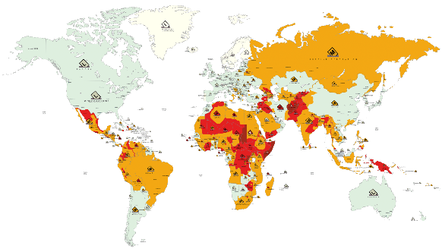
Summary
Key findings for 2023
The company’s overall risk level is currently manageable in proportion to the scope of its operations and the practical measures available for managing these risks.
If global economic growth weakens, it might have adverse effects on new projects under negotiation or on projects in the order backlog.
Financial and political uncertainty in the global economy, coupled with fluctuations in exchange rates and tightening financial market regulations, may have an adverse effect on the availability of financing from banks and capital markets, and could reduce the investment appetite of Valmet’s customers.
The high proportion of business derived from stable business and the geographical diversification will reduce the possible negative effects that market uncertainties may have.
Through acquisitions or mergers Valmet may become exposed to risks associated with new markets and business environments.
Key risks related to projects are cost accounting, scheduling and materials management risks.
Capital business risks are managed by improving and continuously developing project management processes and the related tools.
Changes and uncertainty in the future regulation and legislation may critically affect business opportunities especially in the energy business.
CONFIDENTIAL

Slide 62
Emerging Risks and Must-Wins
Must-Wins
Threats 2023
Customer excellence
1
Global and key market area economic cycles
Customer industry cycles
Company’s brand and reputation
2
8
Leader in technology and innovation
10
Products’ technology cost structure and competitiveness
Excellence in processes
3
Project operations risks
Services business profitability risks
IT systems impact to business performance and continuity
Energy, raw material and supply chain management
Quality risks
Information security risks
Global regulatory development
4
5
6
7
8
Winning team
9

Slide 63
Emerging Opportunities and Must-Wins
Must-Wins
Opportunities 2023
Customer excellence
2
Global and key market area economic cycles
Customer industry cycles
Demand for products and continuity of customer relationship
3
7
Leader in technology and innovation
4
Products’ technology cost structure and competitiveness
Maintaining technology leadership through innovating new breakthrough products
7
Excellence
in processes
1
Company’s mergers and acquisitions target availability and utilization
Company’s global sourcing capability and key material and services sourcing
Services business profitability
Global regulatory development
Energy, raw material and supply chain management
Management competence and capability
5
6
Winning team
9
10
8

Slide 64
Summary of key findings
Risk = opportunity and/or threat
New risks in the top 10 list
  Information security risks
Opportunities
  Company’s mergers and acquisitions target availability and utilization
  Global and key market area economic cycles
  Customer industry cycles
  Products’ technology cost structure and competitiveness
  Company’s global sourcing capability and key material and services sourcing
Threats
  Global and key market area economic cycles
  Project operations related risks
  Customer industry cycles
  Services business profitability
  Global regulatory development

Slide 65
Risks and business uncertainties

Slide 66
Risks and business uncertainties 1/3
Valmet’s operations are affected by various strategic, financial, operational and hazard risks. Valmet takes measures to exploit emerging opportunities and to limit the adverse effects of potential threats. The assessment of risks related to sustainable development holds an important role in risk management. If such threats materialized, they could have material adverse effects on Valmet’s business, financial situation and operating result, or on the value of shares and other securities.
The objective of Valmet’s risk management is to ensure the implementation of an effective and successful strategy for achieving both long- and short-term goals. The task of Valmet’s management is to regulate risk appetite.
In assessing risks, Valmet takes into consideration the probability of the risks and their estimated impact on net sales and financial results. Valmet’s management estimates that the Company’s overall risk level is currently manageable in proportion to the scope of its operations and the practical measures available for managing these risks.

Slide 67
Risks and business uncertainties 2/3
Financial uncertainty in the global economy, coupled with fluctuations in exchange rates and tightening financial market regulations, may have an adverse effect on the availability of financing from banks and capital markets and could reduce the investment appetite of Valmet’s customers. Valmet estimates that the high proportion of business derived from stable business (Services and Automation) and the geographical diversification will reduce the possible negative effects that market uncertainties may have.
If global economic growth weakens, it might have adverse effects on new projects under negotiation or on projects in the order backlog. Some projects may be postponed, suspended, or canceled. In the case of long-term delivery projects, initial customer advance payments are typically 10–30 percent of the value of the project, and customers make progress payments as the project is implemented. This significantly decreases the risks and financing requirements related to Valmet’s projects. Valmet continually assesses its customers’ creditworthiness and their ability to meet their obligations. As a rule, Valmet does not finance customer projects. If economic growth slows down significantly, the markets for Valmet’s products may shrink, which may lead to, for example, tougher price competition.

Slide 68
Risks and business uncertainties 3/3
Changes and uncertainty in future regulation and legislation can also have critical effects, especially on the energy business.
Large fluctuations in energy prices can affect the global economy. These fluctuations can also affect Valmet and its customers, especially in the energy business.
Changes in labor costs and the prices of raw materials and components can affect Valmet’s profitability. Wage inflation is continuing, but Valmet’s goal is to offset this at least partly through increased productivity and strict price discipline. It is possible, however, that tough competition in some product categories will make it difficult to pass on cost increases to product prices. On the other hand, some of Valmet’s customers are raw material producers and their ability to operate and invest may be enhanced by strengthening commodity prices and hampered by declining commodity prices.
To ensure a high level of quality in both production and services, it is important to sustain a high level of competence and talent availability. This includes, for example, maintaining efficient recruitment programs, utilization of existing talent and sharing knowledge globally.
Through acquisitions, Valmet may become exposed to risks associated with new markets and business environments. The actual acquisition process also includes risks. Other risks associated with acquisitions include, but are not limited to, integration of the acquired business, increased financial risk exposure, retention of key personnel and achieving the targets set for the acquired business.

Slide 69
Management of project business risks important
An important part of Valmet’s business consists of project business. Pulp business projects in particular can be large, thus project-specific risk management is crucial. Key risks related to projects are project cost estimation, scheduling, project risk management, quality and performance risks, and materials management risks. Risk analysis shall, as a minimum, take place for all significant project quotations. The work concerning threat and opportunity assessment continues during the execution phase of the project. Risk management is based on careful planning and continuous, systematic monitoring and evaluation. Project risks are managed by improving and continuously developing project management processes and the related systems.
There may be changes in the competitive situation of Valmet’s individual businesses, such as the emergence of new, cost-effective competition in the markets. Valmet can safeguard its market position by developing its products and services, and through good customer service and local presence.

Slide 70
Availability of financing crucial
Securing the continuity of Valmet’s operations requires sufficient available funding under all circumstances. Valmet estimates that its liquid cash assets and committed credit limits are sufficient to secure its immediate liquidity and to ensure the flexibility of financing. The average maturity of Valmet’s non-current debt, excluding lease liabilities, is 3.3 years. Loan facilities include customary covenants, and Valmet is in clear compliance with the covenants at the balance sheet date.
Net working capital and capital expenditure levels have a key impact on the adequacy of Valmet’s financing. Setting aside investments into the renewal of the ERP system, Valmet does not expect any significant increase in annual capital expenditure and estimates that it is well-positioned to keep capital expenditure at the level of total depreciation.
Of the financial risks that affect Valmet’s profit, currency exchange rate risks are among the most substantial. Exchange rate changes can affect Valmet’s business, although the wide geographical scope of the Company’s operations reduces the impact of any individual currency. Economic insecurity typically increases exchange rate fluctuations. Valmet hedges its currency exposures linked to firm delivery and purchase agreements.
Changes in legislation and the way authorities interpret regulation, for example regarding taxation, can also have an impact on Valmet’s financials.

Slide 71
Pandemics and infectious diseases
In case an outbreak and a prolonged pandemics, there could be further adverse impact on Valmet’s operations, customer investment activity, project deliveries, supply chain and availability of financing for both Valmet and its customers.
Epidemic outbreaks and pandemics remain as a heightened risk to Valmet’s operations also after COVID-19.
Pandemics might have impact on the supply chain and business, by increasing the likelihood of interruptions. For example, the rate for security of supply slightly declined in 2021 but improved in 2022.
Valmet’s operations are scattered all around the world – annually we have around 200 scheduled project completions, i.e. customer start-ups with our global customer base, coupled with the fact that also our global suppliers are operating in several countries.
The diversity of our supply chain, delivery operations and customer base mitigate the overall impacts of risks to Valmet, should there be any disruptions in some isolated country or case.
Valmet currently has a large order backlog, strong balance sheet and liquidity coupled with a flexible organization, and a structured way to operate in changing circumstances.
This will aid Valmet in mitigating the global challenges caused by pandemics. Valmet also has a Global Incident Management Team (IMT), a regional and local IMTs to manage Valmet’s response to pandemics.

Slide 72
Mitigating the impacts of Covid-19 pandemic
The coronavirus pandemic, a dynamic, rapidly evolving global crisis that shaped 2020 impacted Valmet’s way of operations in various ways. Protecting health and safety of employees, partners and customers, as well as the communities in which we operate was in the center of day-to-day activities. Also, collaboration with stakeholders to reduce risks to people and our businesses was extremely important.
Valmet established both a global Incident Management Team (IMT) and a local China IMT to manage Valmet’s response to the coronavirus epidemic right in the beginning of the coronavirus outbreak in January 2020. Additionally, management's Global Incident Team (HQ Team), regional and local IMTs were established in March 2020 when the pandemic continued to spread further.
The roles of each IMT were accurately described. The global IMT focused on monitoring the development of the global pandemic situation, sharing updated information to the personnel and preparing global guidelines. The management's HQ Team monitored the global situation, ensured efficient flow of information globally, approved proposals by the global IMT for company-wide operating guidelines and supported the decision-making of local organizations. Regional and local IMTs focused on securing business continuity, creating continuity plans for critical business functions, observing instructions of local authorities, deploying regional instructions and communicating with personnel.
IMTs worked very hard over the course of the year in co-operation with employees, customers, and health authorities in the ever-changing pandemic situations to ensure safety at workplace and continuity of business operations . Despite challenging Covid-19 conditions, Valmet had relatively few confirmed Covid-19 infections throughout the year, especially at Valmet’s own locations.
“We have been able to operate and adapt in an agile way globally, both implementing and updating numerous instructions with growing scientific and medical information and sharing best practices. Clear and timely internal communication has been one key to success. Good instructions help but managing the Covid-19 year was very much about people in all kinds of roles from Project Managers to site employees and their commitment to follow the safety measures and taking care of each other,” says Asko Partti, Vice President of Risk Management and Head of global IMT.
Valmet’s internal Pulse survey showed at the end of the year that engagement and staying connected were on a good level among our Valmeteers. It showed that we as a company were finding ways to manage the changes happening around us.

Slide 73
War in Ukraine – impacts and mitigating actions
The conflict between Russia and Ukraine that started in 2014 concerning certain parts of eastern Ukraine expanded in February 2022 to Russia’s military attack on Ukraine, which caused significant risks and uncertainties to the markets affecting the entire global economic environment and financial markets. World trade, the availability of materials and logistics chains are changing permanently. Companies need to radically change their operating models to operate in this new world.
Approximately 2 percent of Valmet's total net sales came from its Russian operations in 2021. In the spring of 2022, Valmet had a total of approximately 140 employees in Russia, working primarily in sales, engineering, maintenance, and financial administration. Valmet does not have production in Russia.
Valmet has evaluated the long-term impact of the situation in Ukraine, reviewed key contractual obligations, project schedules, and identified risks for projects that are delivered to Russia. Based on the review, Valmet has identified projects that no longer meet the criteria of a customer contract for revenue recognition purposes, and has consequently made a reversal of approximately 70 MEUR to its order backlog as at March 31, 2022. Other than the reversal made to Valmet’s order backlog, the Russian government’s invasion of Ukraine did not have a material impact on the results or financial position of Valmet, or its financial reporting for the first quarter of 2022.
Valmet does not enter new sales projects in Russia. We are terminating our legal units in Russia taking into account the local legislation and the safety of our employees. We carefully comply with all sanctions and export regulations and are discussing with our customers on the impact of these on our contract obligations. It is possible to source specific components also from some alternative suppliers and no new purchases from Russia will be made. Russia represented around 2% of Valmet's net sales and 0.1% of procurement spend In 2021.
Valmet will withdraw from Russia completely and will continue to implement the withdrawal in stages as the review of implementation options is fully completed.
Valmet has established a special Incident Management Team (IMT) to manage the impacts of the war in Ukraine on the company. Additionally, our top management and many functions, like HSE, Legal, Sourcing, HR and IT, are also actively assessing the situation and making needed decisions. Valmet actively complies with all sanctions and export regulations impacting business with Russia and Belarus and monitors development carefully. Valmet continues in reviewing its operations in Russia and implementing its exit plan.
If the war is further prolonged or geopolitical tensions increase further, there could be additional advers long-term impacts on Valmet’s operations, customer investment activity, project deliveries, availability and prices of components, supply chain and availability of financing for both Valmet and its customers.

Slide 74
Climate related regulation and initiatives
Climate-related risks in Valmet’s own operations relate to increased costs and administrative burden due to changes in regulations and policies in the areas of climate, energy and environment.
Stricter climate-related regulation and initiatives may change the availability and use of biomass, and increase the cost of raw materials and energy, result in new taxes and tariffs, and change our stakeholder’s attitudes, which could impact Valmet’s and its customers’ operations and business environments. E.g. in 2021, Valmet identified European Green Deal and related initiatives, such as the Carbon Border Adjustment Mechanism, Fit for 55 -package, Taxonomy, emerging forest and biodiversity strategies, as a regulatory risk for Valmet's business, as it will influence how sustainable forest use and Valmet's technologies are seen in the market in long-term future.
Potential business impacts of climate change to Valmet come mainly from international agreements as well as national and regional commitments to carbon neutrality. These drivers mobilize developments that also in the mid and short-term affect our operating environment. Potential business impacts of climate related regulation to Valmet relate to international agreements as well as initiatives and emerging legislation under the European Union will increase in the long term.
Uncertainty related to biomass availability and EU level legislation that would limit our customers’ access to biomass and possibilities for new investments in the region would have a significant financial and strategic impact on Valmet. Changes and uncertainty in future regulation and legislation can also have critical effects, especially on the energy business.
Valmet has a systematic, global approach to manage legislative and regulatory risks related to Valmet’s whole value chain. Valmet mitigates and controls the risk by being active in the policy advocacy work in order to secure informed decision-making. Mitigating actions include the management of the potential risks and opportunities via monitoring the political debate and decision-making processes on to be able to adapt to and take advantage of the changing environment. Valmet also participates discussions though its association networks and directly with decision-makers.
Climate related risks and opportunities are also assessed annually on a group-level by Valmet´s Risk Management incl. actions, accountabilities, time frame and decisions to treat the residual risk.
We monitor these on EU-level and globally continuously and systematically, and these are taken into consideration in our policy advocacy work and when making strategic or business decisions.
In 2021-2022 Valmet conducted climate scenario analysis to further evaluate climate related regulatory risks and their financial implications.

